Slide 1



+
Android without Google
Andrew Rabert

Slide 2
My Pocket Computer
Camera
Web browsing
Chat
Email
Music
Games
RSS
Navigation
Calendar
Phone
One-Time Passwords
Task Management
Notes
SSH
Reading
Alarms
Calculator
Flashlight
Notes:
- no GUI, no browser – just basic command line stuff
- “releases” are simply snapshots
- Generally latest stable packages
- Generally vanilla. Other distros apply various patches (Ubuntu and fonts).

Slide 3
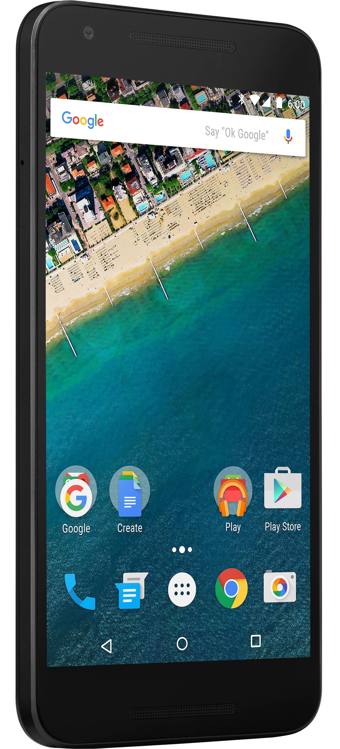
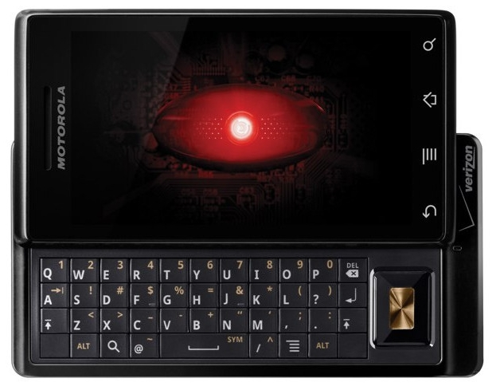
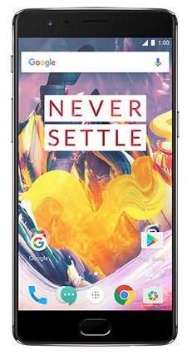
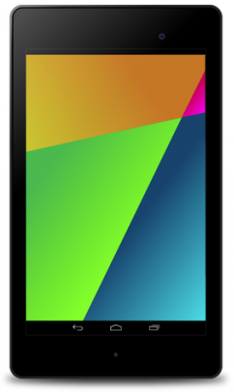
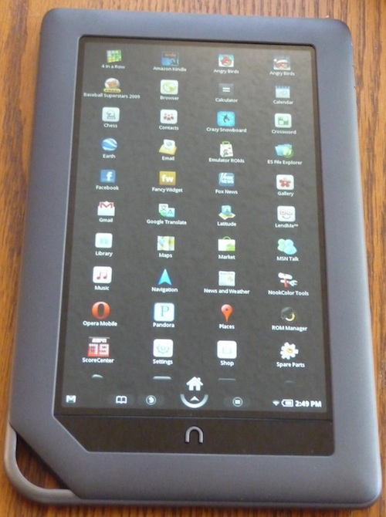
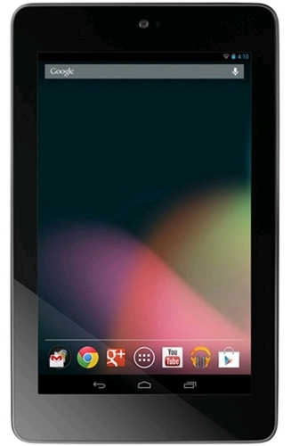
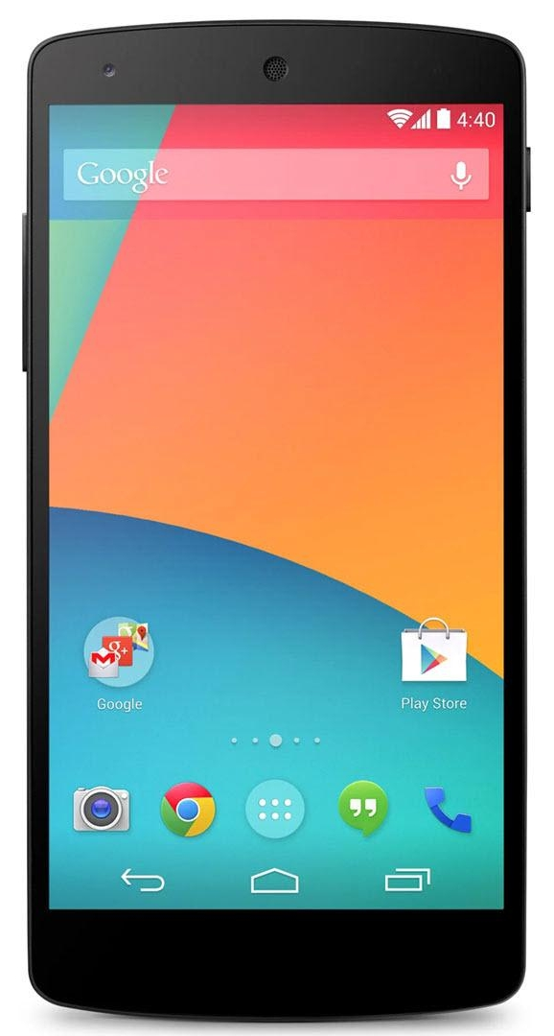
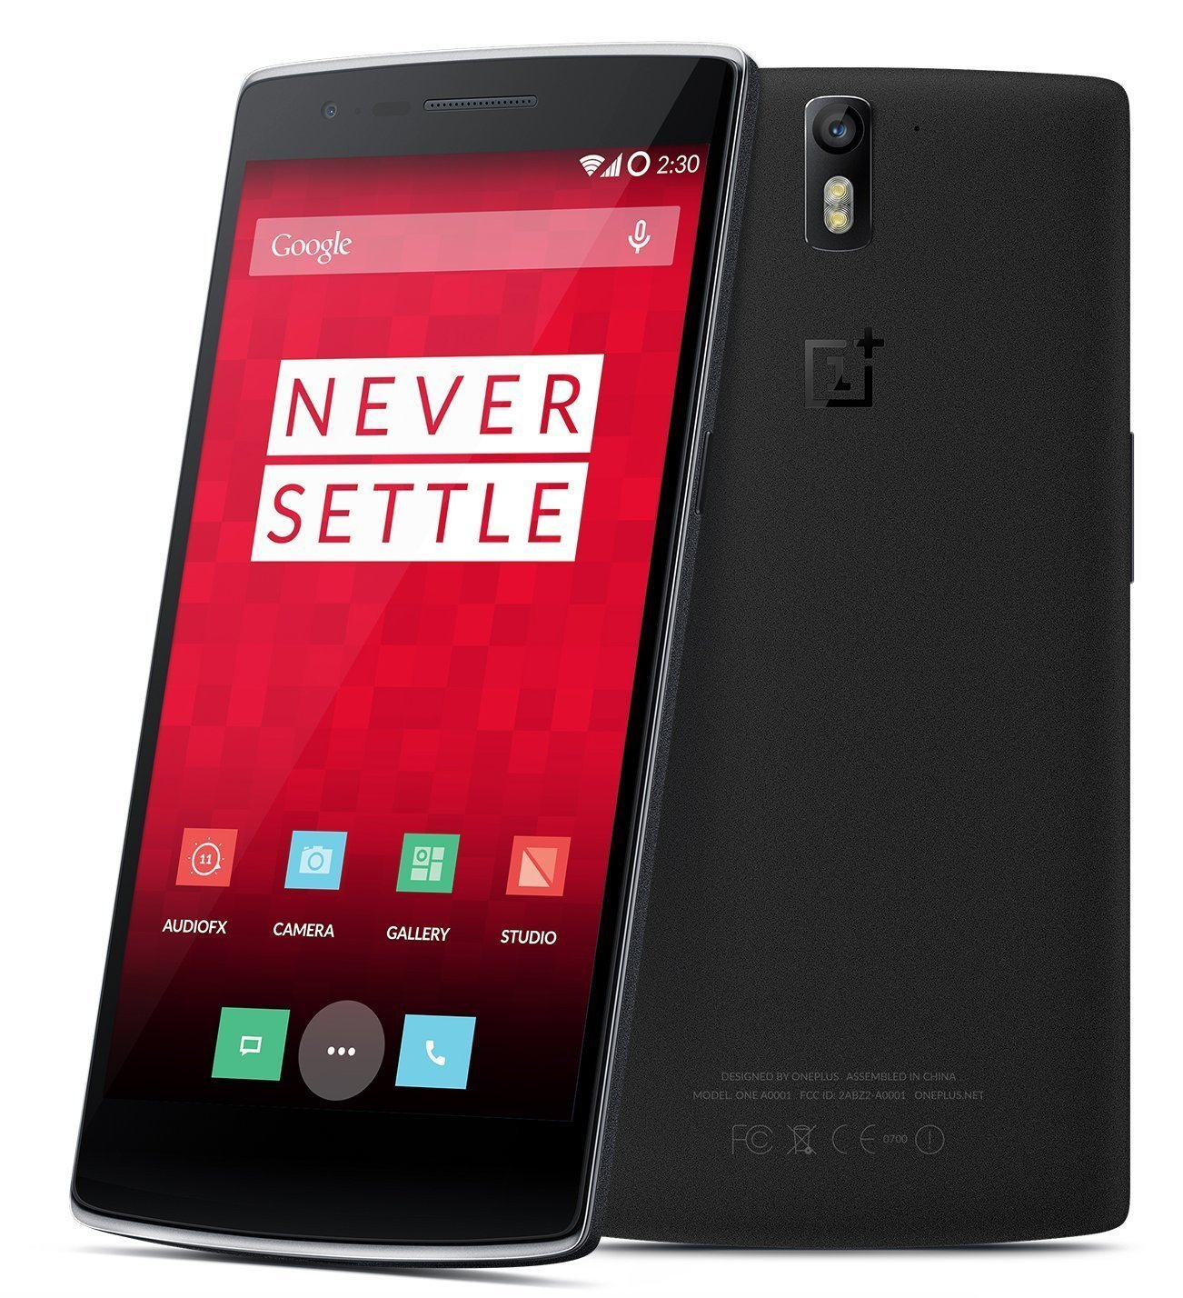
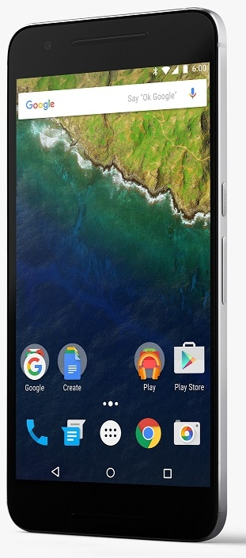
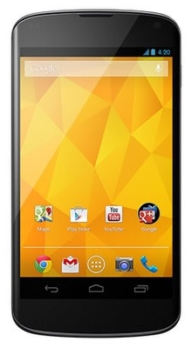
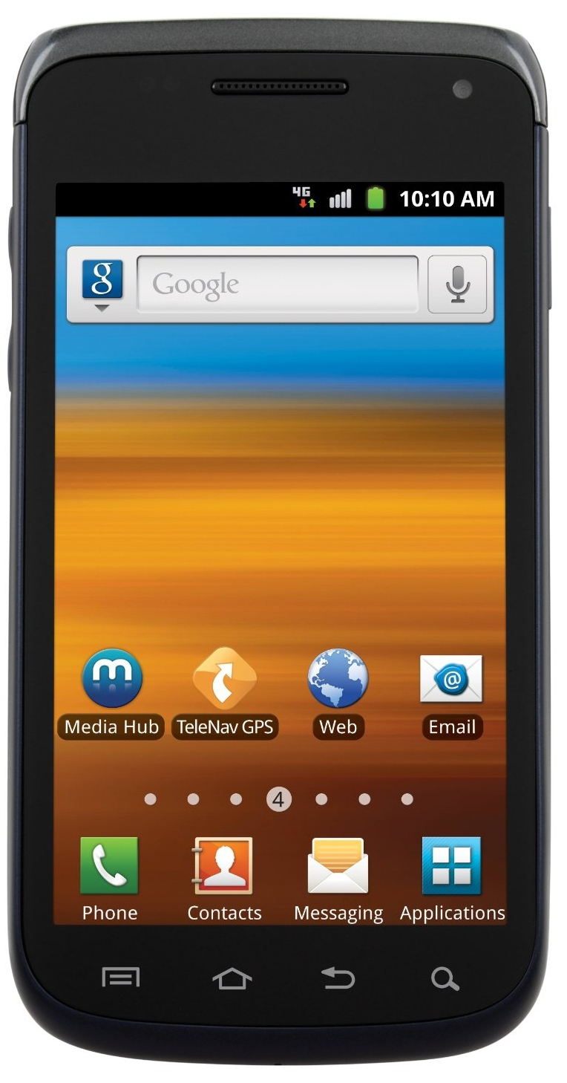
Andrew + Android = Andrwoid?
User since 2009
Previously Symbian and Windows Mobile
iOS = closed platform
Android = open source
Notes:
- no GUI, no browser – just basic command line stuff
- “releases” are simply snapshots
- Generally latest stable packages
- Generally vanilla. Other distros apply various patches (Ubuntu and fonts).

Slide 4
Usage Patterns
Always rooted
  Kernel tweaks
  Ad blocking
  Features!
Always custom
  Faster updates
  Stability
  Features!!
…and Google.
Notes:
- no GUI, no browser – just basic command line stuff
- “releases” are simply snapshots
- Generally latest stable packages
- Generally vanilla. Other distros apply various patches (Ubuntu and fonts).

Slide 5
AOSP
Android Open Source Project
The official Android
The stock in stock experience
Owned by Google
Barebones
Limited device support
Notes:
- no GUI, no browser – just basic command line stuff
- “releases” are simply snapshots
- Generally latest stable packages
- Generally vanilla. Other distros apply various patches (Ubuntu and fonts).

Slide 6

LineageOS
Custom ROM
Near-stock Android experience
  Built atop AOSP
Google Play Services not included
Extra features
  Bluetooth battery
  Quick tiles
  More!
Consistent across supported devices
Works great on my OnePlus 3T!
Notes:
- no GUI, no browser – just basic command line stuff
- “releases” are simply snapshots
- Generally latest stable packages
- Generally vanilla. Other distros apply various patches (Ubuntu and fonts).

Slide 7












Google Play Services & Apps
aka Play Store
Available on 99% of Android phones.*
Cannot be included directly in custom ROMs
Includes API’s for:
  Location / Maps
  Google Play Games
  IAP’s (In-App Purchases)
  DRM
  Android Wear
Notes:
- no GUI, no browser – just basic command line stuff
- “releases” are simply snapshots
- Generally latest stable packages
- Generally vanilla. Other distros apply various patches (Ubuntu and fonts).

Slide 8

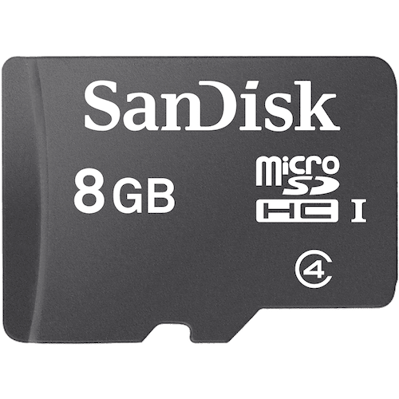

Slide 9
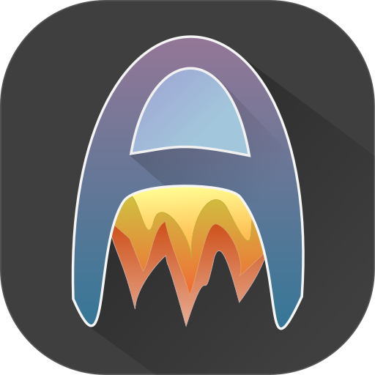
Audio Streaming
Already had music collection
Google Play Music too limited
  Crappy UI
  Poor organization
  Closed API
Settled with Madsonic + Dsub
  Self-hosted
  My music
  Open source!
Now Airsonic + Audinaut
Notes:
- no GUI, no browser – just basic command line stuff
- “releases” are simply snapshots
- Generally latest stable packages
- Generally vanilla. Other distros apply various patches (Ubuntu and fonts).

Slide 10
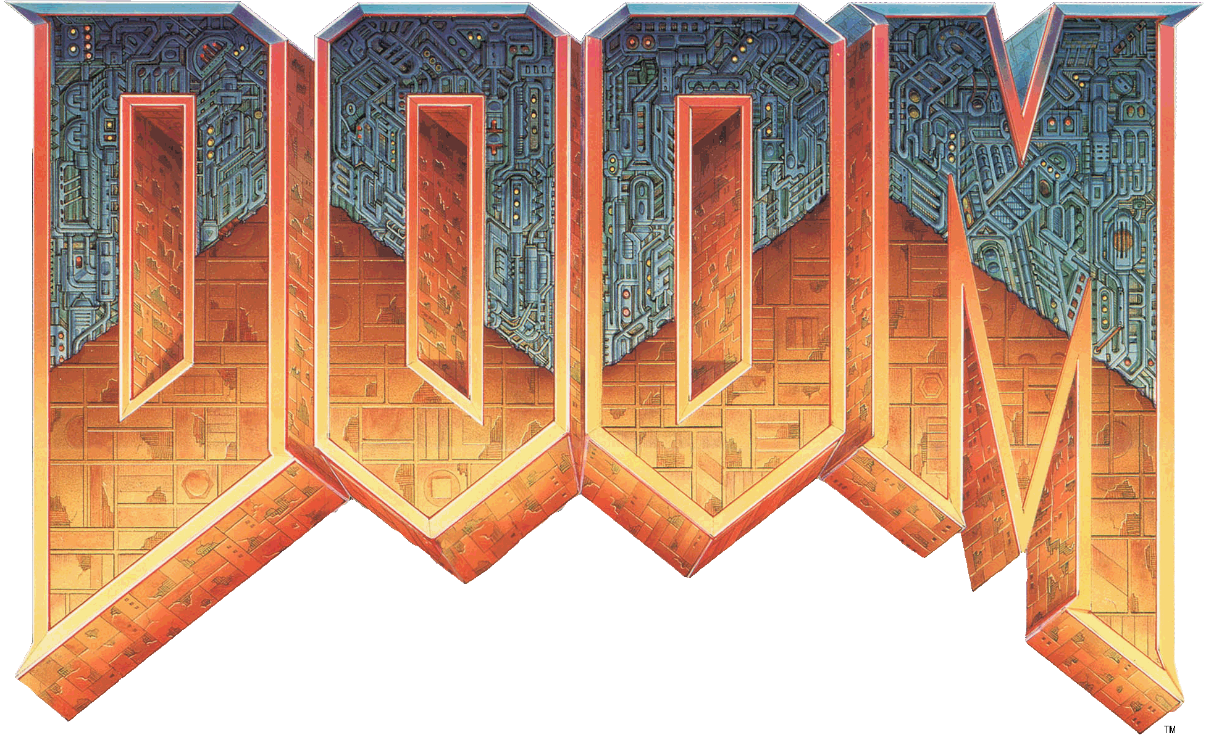

Slide 11

Doom for DOOM
Google removed D-Touch
  Developer violated terms
  Account perma-banned
  Lost access to paid app
Developer re-released on
Amazon App Store
Later forked to
GZDoom for Android
^^ free on my GitHub!
Notes:
- no GUI, no browser – just basic command line stuff
- “releases” are simply snapshots
- Generally latest stable packages
- Generally vanilla. Other distros apply various patches (Ubuntu and fonts).

Slide 12





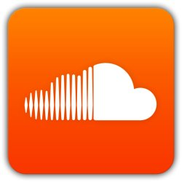







Amazon App Store
Amazon’s proprietary app store
Paid and free apps
Not on Play Store
Side-loadable!
Notes:
- no GUI, no browser – just basic command line stuff
- “releases” are simply snapshots
- Generally latest stable packages
- Generally vanilla. Other distros apply various patches (Ubuntu and fonts).

Slide 13






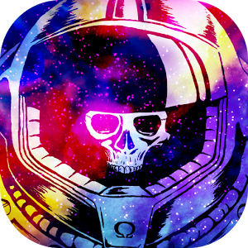



Humble Bundle
DRM-free game bundles
Some also sold individually
Often not updated
Hit-or-miss
Notes:
- no GUI, no browser – just basic command line stuff
- “releases” are simply snapshots
- Generally latest stable packages
- Generally vanilla. Other distros apply various patches (Ubuntu and fonts).

Slide 14


Slide 15
Ad Company Blocks Ad Block
Google removed AdAway from Play Store
Blocks ads in apps and browsers
Open source
Still available on F-Droid
Notes:
- no GUI, no browser – just basic command line stuff
- “releases” are simply snapshots
- Generally latest stable packages
- Generally vanilla. Other distros apply various patches (Ubuntu and fonts).

Slide 16

F-Droid
Free and open source app repository
No proprietary code
User repositories
AdAway and other banned apps
Notes:
- no GUI, no browser – just basic command line stuff
- “releases” are simply snapshots
- Generally latest stable packages
- Generally vanilla. Other distros apply various patches (Ubuntu and fonts).

Slide 17
Google Banned Apps In F-Droid
AdAway
  System-level ad blocking
Transdroid
  Torrent server management with search
NewPipe
  YouTube client
  Also supports downloading and audio-only streaming
Yalp Store
  Alternative Google Play Store client
  ???
Notes:
- no GUI, no browser – just basic command line stuff
- “releases” are simply snapshots
- Generally latest stable packages
- Generally vanilla. Other distros apply various patches (Ubuntu and fonts).

Slide 18

Yalp Store
Unofficial, open source Google Play Store app
Free apps without account
Paid apps with account
  Must have purchased them
Updates apps
Violates TOS
Notes:
- no GUI, no browser – just basic command line stuff
- “releases” are simply snapshots
- Generally latest stable packages
- Generally vanilla. Other distros apply various patches (Ubuntu and fonts).

Slide 19



Slide 20
Go Host Yourself

Slide 21









Self-Hosting
Contact and calendar sync
RSS feeds
File storage and sync
Audio & video streaming
Notes:
- no GUI, no browser – just basic command line stuff
- “releases” are simply snapshots
- Generally latest stable packages
- Generally vanilla. Other distros apply various patches (Ubuntu and fonts).

Slide 22
Files, contacts, calendar, notes, RSS…
Community supported extensions
Apps on all major platforms
Web view is fantastic
Open source
Notes:
- no GUI, no browser – just basic command line stuff
- “releases” are simply snapshots
- Generally latest stable packages
- Generally vanilla. Other distros apply various patches (Ubuntu and fonts).

Slide 23
Distributed file synchronization
Minimal impact to battery on mobile
Apps on all major platforms
Synchronizes todo.txt, notes, photos
Notes:
- no GUI, no browser – just basic command line stuff
- “releases” are simply snapshots
- Generally latest stable packages
- Generally vanilla. Other distros apply various patches (Ubuntu and fonts).

Slide 24
Video streaming platform
Automatically identifies video metadata
Has apps – no need to use them
Works great in the browser
Nagware
  Soft-forked to emby-unlocked
Notes:
- no GUI, no browser – just basic command line stuff
- “releases” are simply snapshots
- Generally latest stable packages
- Generally vanilla. Other distros apply various patches (Ubuntu and fonts).

Slide 25
pass
Minimalist password manager
GPG-based
Versioned with git
Synchronized over SSH
Sweet Android app: Password Store
Uh… it works for me
Notes:
- no GUI, no browser – just basic command line stuff
- “releases” are simply snapshots
- Generally latest stable packages
- Generally vanilla. Other distros apply various patches (Ubuntu and fonts).

Slide 26
Apps?

Slide 27
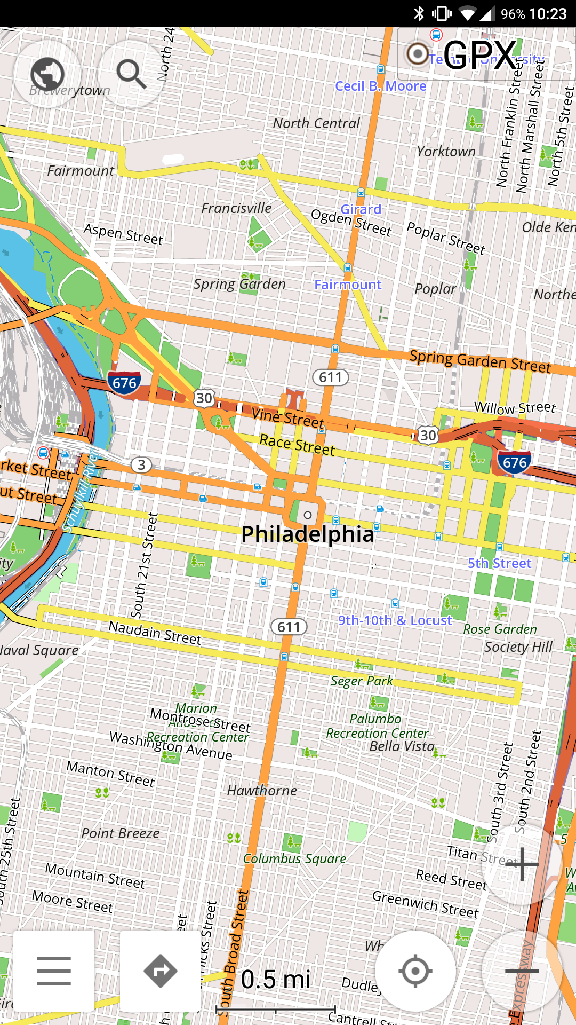
OsmAnd
GPS and maps
Trip recording
Uses OpenStreetMaps
Offline navigation!
Pairs well with AddressToGPS
Notes:
- no GUI, no browser – just basic command line stuff
- “releases” are simply snapshots
- Generally latest stable packages
- Generally vanilla. Other distros apply various patches (Ubuntu and fonts).

Slide 28








Noteworthy Apps
Browser: Firefox
Email: K-9 Mail
Facebook: Face Slim
Reddit: Slide
Camera: Open Camera
Gallery: Gallery
SMS: Silence
SSH/Terminal: Termux
Notes:
- no GUI, no browser – just basic command line stuff
- “releases” are simply snapshots
- Generally latest stable packages
- Generally vanilla. Other distros apply various patches (Ubuntu and fonts).

Slide 29
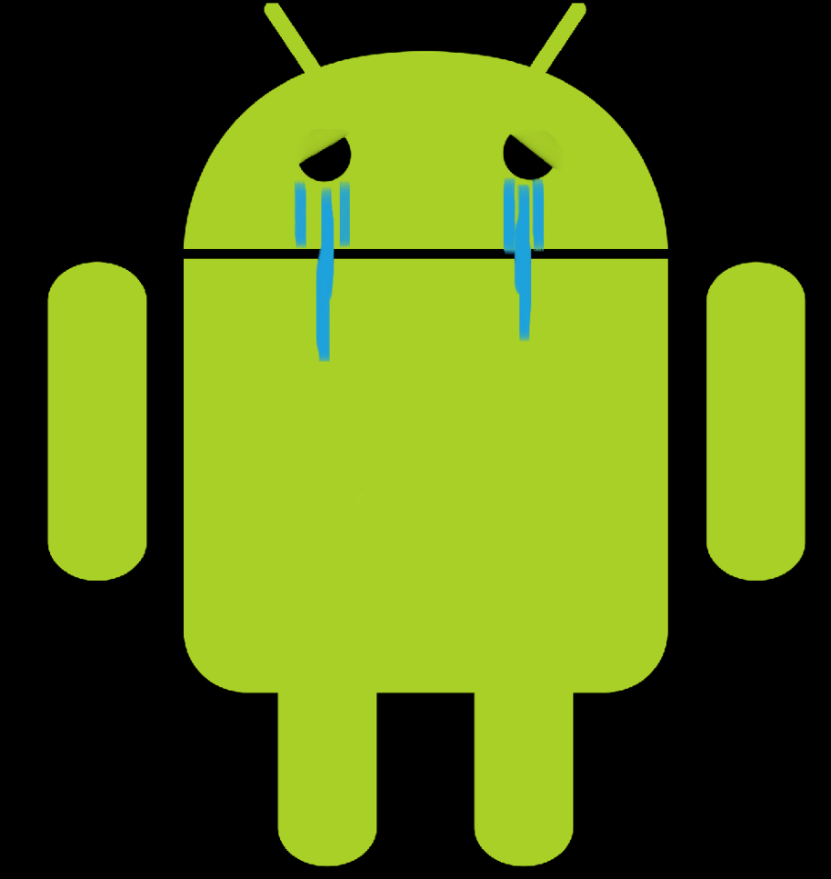

Slide 30

Issues
Google no longer releases Play Service-free development images
Breaks Google Cloud Messaging
  Trouble with proprietary chat services
Mobile site experiences vary
Device selection
Tinder doesn’t work
Notes:
- no GUI, no browser – just basic command line stuff
- “releases” are simply snapshots
- Generally latest stable packages
- Generally vanilla. Other distros apply various patches (Ubuntu and fonts).

Slide 31



Slide 32

Andrew Rabert
nullsum.net

